Slide 1

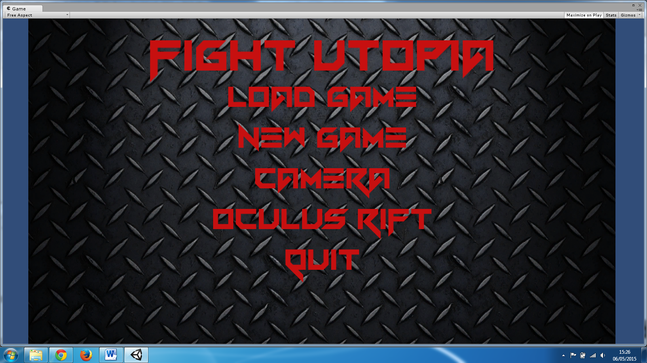
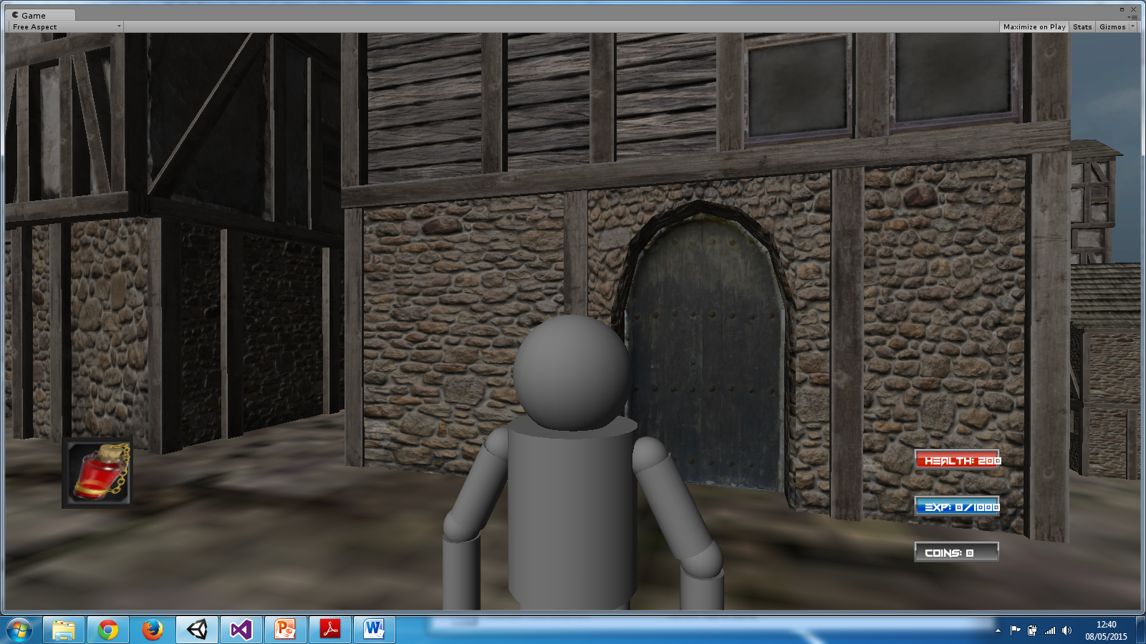

Sean Hoey BSc Honours in Computing
Fight Utopia
Fight Utopia is an open world role-playing game(RPG) set in Tournaville. Where You must fight to survive or to rule.
Project Explanation
During making my game I complete the following task:
Combat System:
I create a simple fighting system using ray cast, to determine how close an enemy is and if the enemy is close enough the player will hit the enemy.
Modelling and animations
I decided to create my own character and animated it in Maya. This allowed me to increases my skills using Maya.
Create a save system
In my game I save the players progress through an XML file. I have a script that reads and writes the player progress to an XML on the computer.
Unity and C#
Visual Studios
Maya
PlayStation 3 Controller
Oculus Rift
Technologies used

